Slide 1
Am Jammer
Ahmad Abdullah & Rafay Aamir Production house

Slide 2
What is modulation?
Modulation is the process of varying one or more properties of a periodic waveform, called the carrier signal, with a separate signal called the modulation signal that typically contains information to be transmitted.

Slide 3

Why do we need modulation?
For efficient transmission of signals of wavelengths λ the minimum length of antenna should be λ/4.
$$size of antenna= \frac{λ}{4}$$
The following equation shows the relationship between the frequency f and wavelength λ of a wave:
$$λ=\frac{v}{f}$$
So;
$$size of antenna ∝ \frac{1}{f}$$
The message signals have a very low frequency due to which these signals cannot be transmitted over long distances requiring extremely large antennas.

Slide 4
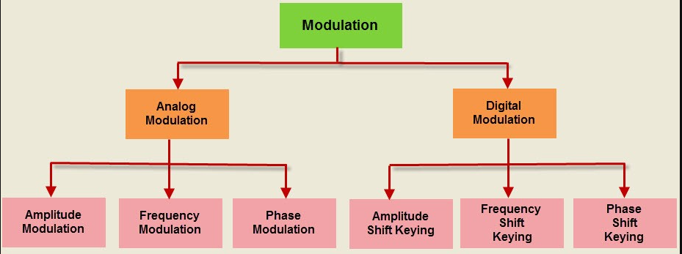
Types of modulation

Slide 5
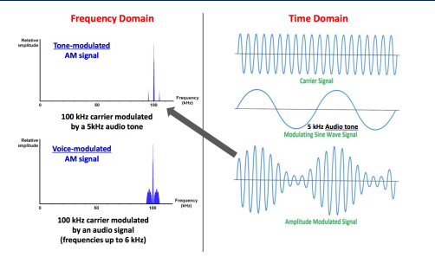
What is Amplitude Modulation (AM)?
Modulation of the amplitude of a radio carrier wave in accordance with the strength of the audio.

Slide 6
Why do we need AM?
Advantages of using AM:
is a low cost.
It requires a lower carrier frequency.
It is easily available.
Require a simple and cheaper transmitter and receiver.
An easier method for transmitting and receiving an audio signal
It is simple with proven reliability.
It can be demodulated using a circuit consisting of very few components
AM receivers are very cheap as no specialized components are needed.

Slide 7
Jammer:
Radio jamming is the deliberate jamming, blocking or interference with wireless communications. In some cases, jammers work by the transmission of radio signals that disrupt communications by decreasing the signal-to-noise ratio. The concept can be used in wireless data networks to disrupt information flow.

Slide 8
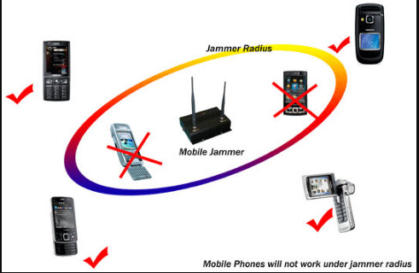
AM Jammer
An AM Jammer transmits black---noise having carrier frequency of the targeted AM signal. The transmitted signal has high amplitude for effective interference.

Slide 9
What is USRP?
NI Universal Software Radio Peripheral (USRP) devices are software defined radios (SDR) used for RF applications. NI USRP transceivers can transmit and receive RF signals in several bands. Paired with the LabVIEW development environment, USRPs provide an affordable solution that lets you validate wireless algorithms with over-the-air signals.

Slide 10
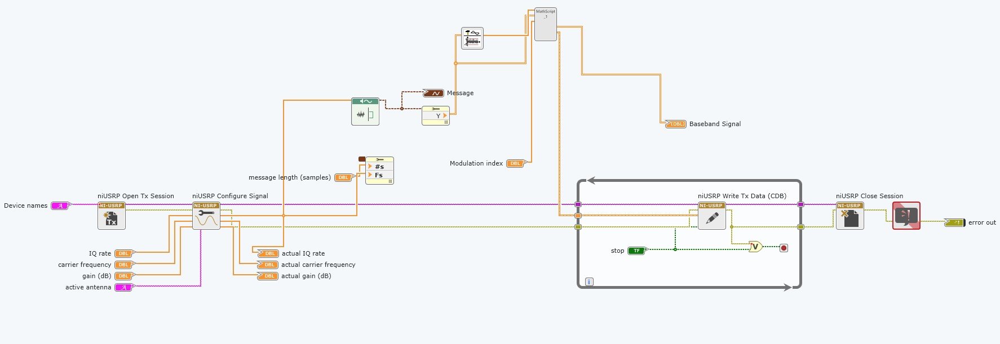
Block diagram in LabVIEW:

Slide 11
Uses of AM Jammer
Normally jammers are used in government offices in some countries, but jammers are mainly used by military, navy, air force and entire defense systems.

